Slide 1
PDR - 3D-ROMAP
R Dominick, L Gogley, M Munoz, D Tran

Slide 2
3D-Robotic Mapping Platform (3D-ROMAP)
System Overview
Project goal is to design and implement a robotic ground unit to capture depth and image data.
The project is intended for research, and targets exploration, such as indoor / outdoor mapping.
System is divided into three categories:
  Positional data recording
  3D image capture and processing
  Robotic assembly and control
Notes:
Liam

Slide 3
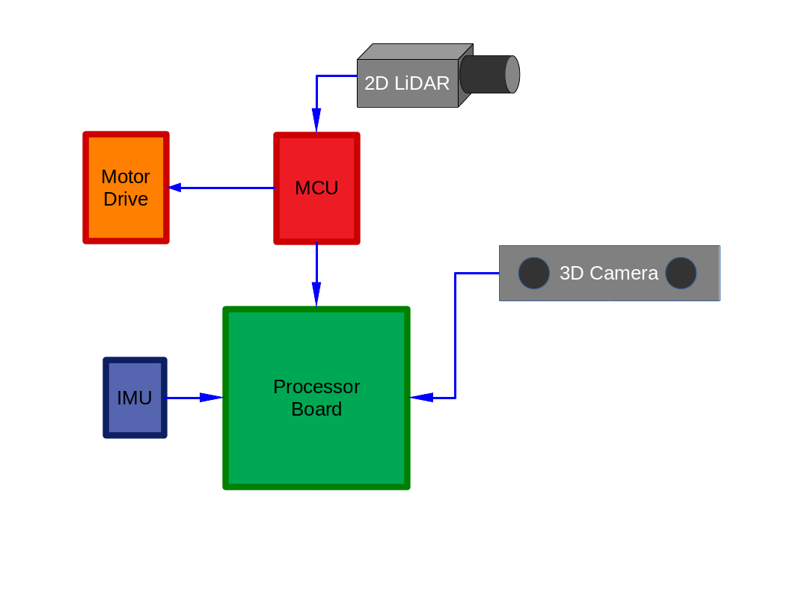
Top Level Block Diagram
Processor Board - NVIDIA Jetson
MCU - Tiva C Launchpad
3D Camera - Intel Realsense
2D LiDAR - LiDAR Lite v1
IMU - 9DoF IMU
Motor Driver - Stepper & H-Bridge
Notes:
Liam

Slide 4
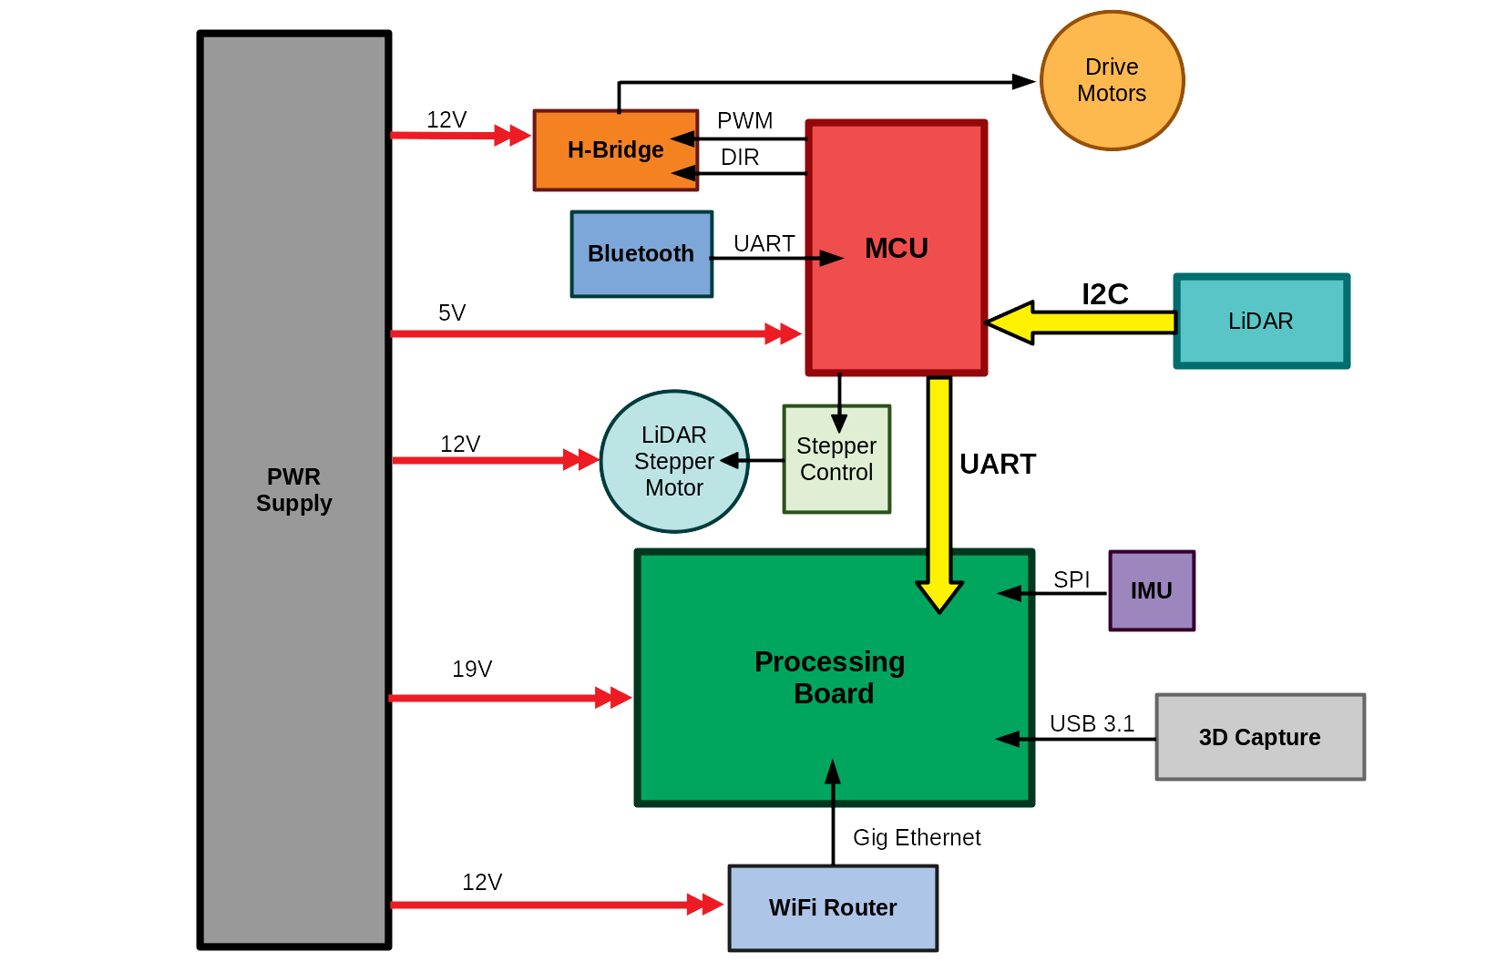
Detailed Block Diagram
Notes:
Liam

Slide 5
Requirements
The design shall map unknown coordinates through exploration on passable terrain.
  Location of choice should not dictate mapping method, i.e. a room vs a field.
The design’s structural capture shall be capable of producing a visual map.
  The scans must produce an image with the desired map.
The design shall be capable of 2D SLAM.
  SLAM shall be used to handle 2D coordinate recognition, and assist in 3D sampling.
The design shall be capable of 3D capture.
  3D capture can be pulled from samples or from real-time/soft real-time capture.
The design shall be powered from an independent power supply.
  This power source shall provide enough power to explore, at minimum, 20 minutes of capture.
Notes:
Liam

Slide 6
Limitations
The design is not confined to low light, visible image capture.
  High resolution 3D structural capture is used to compensate for loss of visuals under low light.
The design is not confined to autonomous navigation, simply the capability of such.
  The design will be capable of mapping and localization, but the platform may not drive autonomously as functionality of mapping is the first priority.
The design is not confined to real-time 3D mapping.
  Real-time 3D is sometimes limited to ability of hardware readout, and may be an unrealistic endeavor. 3D may instead be done from sampling and post-processing.
The design is not interested in object recognition.
  Point clouds will be used to simply display captured “maps”, and points on a 2D plane will only be used to determine the explored area.
Notes:
Liam

Slide 7
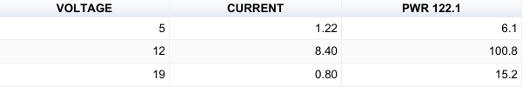
Power Source
Runtime = (10 * Ampere Hours) / Load in Watts
24V - Two 12v (7Ah) batteries
0.57 Hours = (10*7) / 122.1
Notes:
Table pulled from PWR sheet
Liam

Slide 8
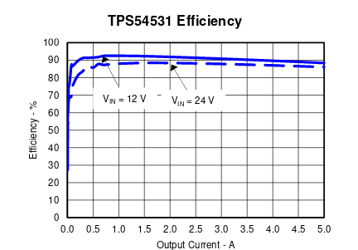
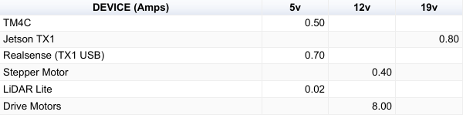
Voltage Requirements
DC-DC Buck Converter
TI - TPS54531
  5A continuous current
  High efficiency at light loads
  570KHz switching frequency
Notes:
Table pulled from PWR sheet
Liam

Slide 9
Positional Mapping

Slide 10
Goal of SLAM
Use various sensors to collect data from the environment and provide an accurate estimation of where to robot is in the room at any given time
Keep track of previously maneuvered areas and use this data to create a 2 Dimensional map
Notes:
Mark

Slide 11
Data Useful to SLAM
Distance measurement from LiDAR sensor
Positional change from odometers
Angular velocity collected from gyro
Directional acceleration from accelerometer
Magnetometer essentially serves as a compass
Notes:
Mark

Slide 12
Landmark Extraction
Landmarks are chosen based on the following criteria:
  They are easily re-observable
  Should have enough landmarks so that the robot will never be maneuvering without a visible landmark
  Should not have so many landmarks the robot has difficulty determining which landmarks have been previously seen
  Examples include well defined corners, desks, and other objects with well defined edges
Notes:
Mark

Slide 13
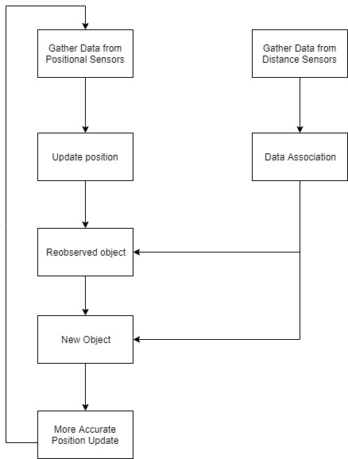
Possible SLAM Implementation
Data association
  Look at previously seen landmarks and decide if what is currently being scanned matches
  If matches, give more precise position
  If no match, add to list of known landmarks
Notes:
Mark

Slide 14
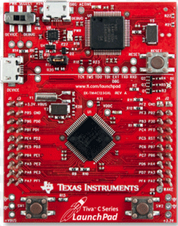
Microcontroller
TI Tiva C Launchpad
TM4C123GH6PM MCU:
  80MHz 32-bit ARM Cortex M4
  256KB Flash, 32KB SRAM, 2KB EEPROM
  Two Controller Area Network (CAN) modules
  USB 2.0 Host/Device/OTG + PHY
  Dual 12-bit 2MSPS ADCs, motion control PWMs
  8 UART, 6 I2C, 4 SPI
On-board In-Circuit Debug Interface (ICDI)
USB Micro-B plug to USB-A plug cable
Notes:
Mark

Slide 15
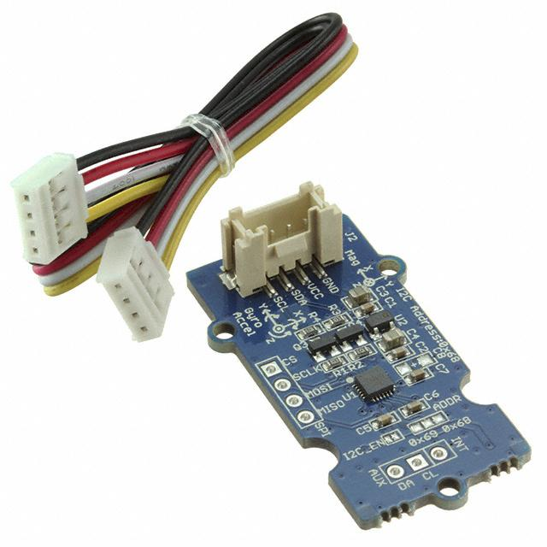
IMU Position Tracking
MPU-9250 - 9DoF IMU
Accelerometer
  3 DoF X, Y, and Z
Gyro
  3 DoF roll, yaw, and pitch
Magnetometer
  3 DoF magnetic field detector
Notes:
Daniel: In order to extract positional data for our SLAM algorithm, one of the hardware components we’ll be utilizing is an Inertial Measurement Unit (or IMU). We’ve decided to use the MPU-9250 IMU. It contains an accelerometer a gyro, and a magnetometer, all of which sum up to 9 degrees of freedom. We’re currently testing whether or not we’ll utilize this or utilize the visual maps that we generate for positional tracking.

Slide 16
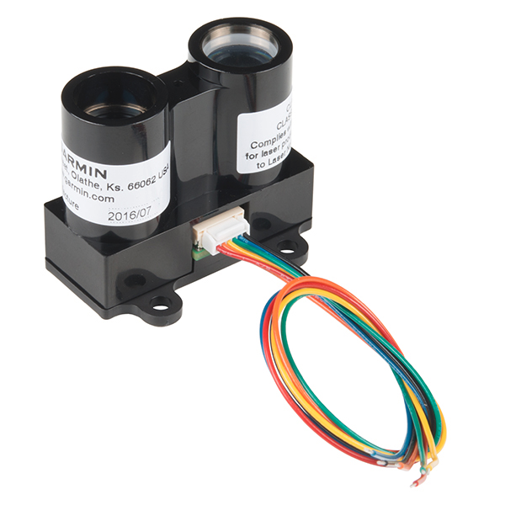
2D Capture
PulsedLight LiDAR Lite v1
  Class 1 infrared laser
  100Hz sample rate
  I2C or PWM connection
  Distance range of 40m
  Accurate to +/-2.5cm
  Max current 130mA
Notes:
Daniel : Another hardware component we will be utilizing in our design is a LiDAR sensor. The specific sensor we’ve chosen to implement is the LiDAR Lite v1, which is a Class 1 infrared laser. It has a 100 Hz sample rate and is interfaced through either I2C or a PWM connection. It has a distance range of 40m accurate to +/- 2.5cm.

Slide 17
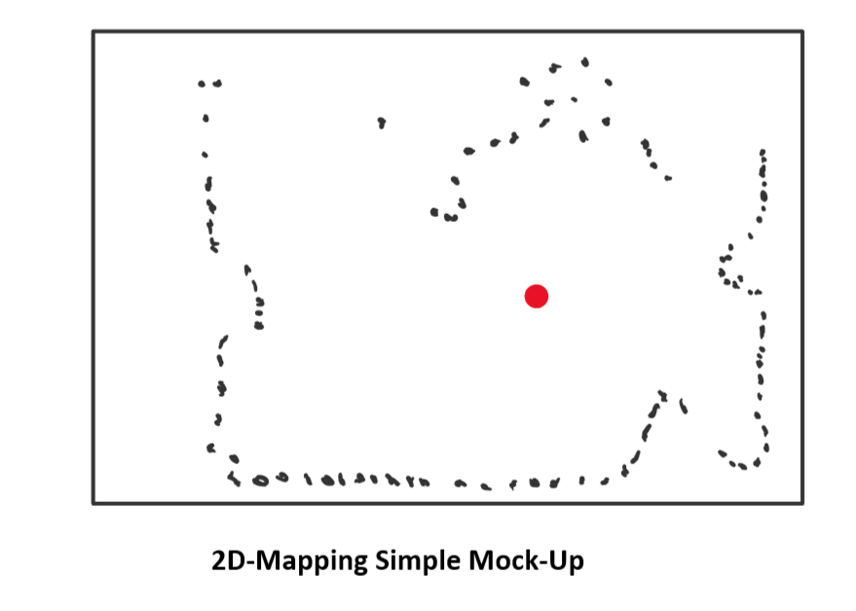
LiDAR Sensor - Overview and Purpose
The LiDAR Lite v1 Sensor will be utilized to generate a 2D-representation of the environment around the robot
  Similar to a top-down of a videogame mini-map
  Map will contain robot’s positional data in the environment
  Simultaneously map the environment and know its current position in the environment (SLAM)
Notes:
Daniel : The main purpose of the LiDAR sensor in our design is to generate a 2D representation of the environment around the robot. You can think of it as a map similar to a top-down map in a videogame that shows your character’s position. As you can see in this simple mock-up example, the map will contain information on the position of the robot in the environment as well as the given environment itself around the robot. In other words, it will simultaneously map the environment and know its current position in the environment (SLAM). Now in order to actually generate a map, we have to capture the data from the LiDAR sensor itself.

Slide 18
LiDAR Sensor - Capturing Distance Values
Interfacing the LiDAR Sensor with the TM4C123 MCU
  Utilize the I2C Protocol
  LiDAR will return a distance value(cm)
  Feed the data to the NVIDIA Jetson board for processing
Use the captured distance reading, process the data, and plot the data points on a 2D cartesian plane
  The 2D plane will be the representation of the environment around the robot
  The robot’s location will also be represented as a separate point on the map
Notes:
Daniel : In order to capture the data from the LiDAR sensor, we will communicate the data coming from the LiDAR sensor to the TM4C Microcontroller using the I2C protocol. In this case, the TM4C acts as the Master and the sensor as the slave. The LiDAR will then return a distance value based on the time of flight. We will then feed this data to the NVIDIA Jetson board for processing. We’ll take the captured distance readings and plot them on a 2-dimensional cartesian plane, which will essentially be the 2d map of the environment. The robot’s location will also be represented as a separate distinct point on the map. Now to get these actual data points that make up the environment, we must sample different locations at a certain rate.

Slide 19
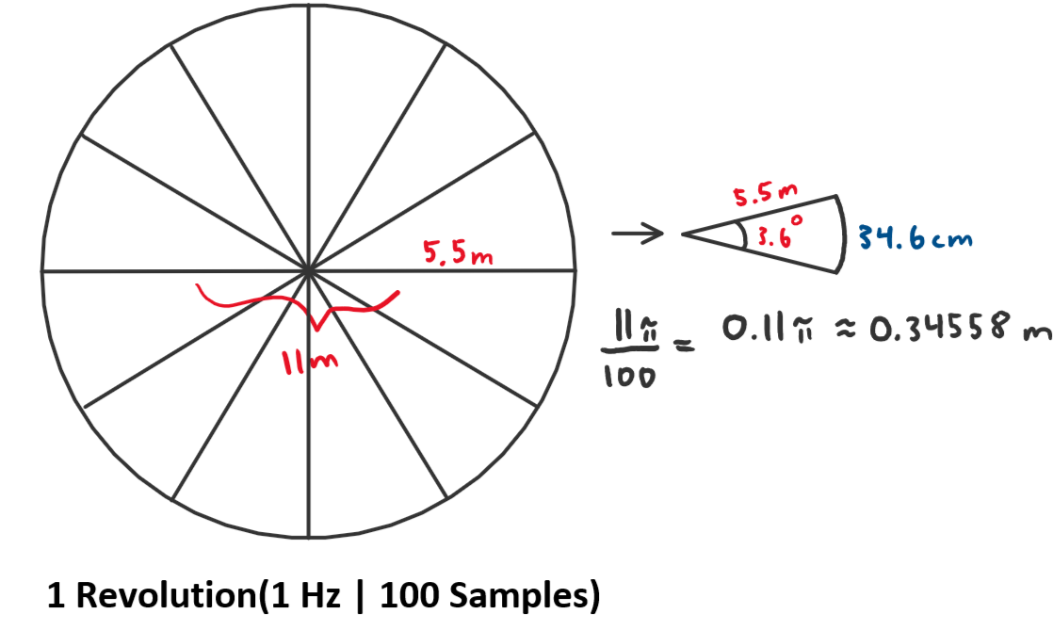
LiDAR Sensor - Method of Sampling
Rotate the LiDAR on a Stepper Motor
Assumptions:
  Rotate the Motor at 1Hz. This will provide 100 sample points in 1 revolution
  Estimate average radius = 5.5m
  Circumference = 11π
11π/100 samples = 34.6 cm between each sample
Notes:
Daniel: The method of sampling with the LiDAR sensor involves mounting the stepper motor on a platform and slowly rotating it using a stepper motor. For now, we’ll be making the following assumptions:
We’ll be rotating the motor at 1 Hz, which will provide us 100 samples per revolution. One revolution being one complete scan of the environment.
If we plot this and estimate the average radius between each sample to be 5.5m, that gives us a circumference of 11pi.
If we take 11pi and divided it by 100 samples, that gives us approximately 35 cm between each sample.

Slide 20
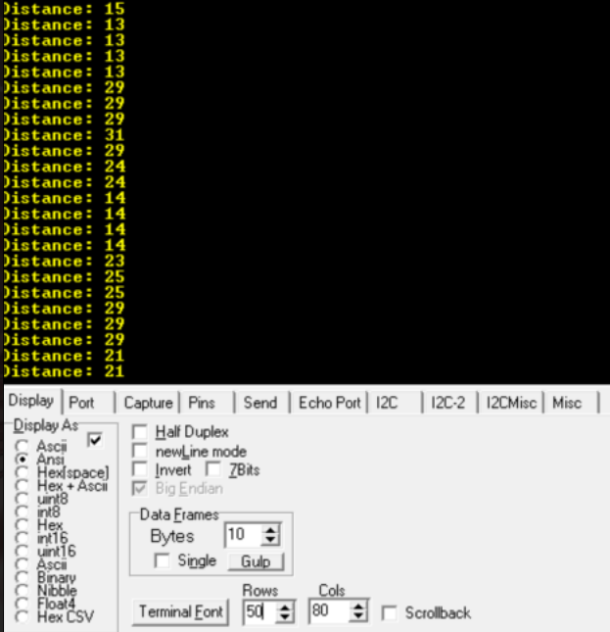
LiDAR Sensor - Verification
The following terminal output showcases the LiDAR sensor successfully interfacing with the TM4C.
  The LiDAR sensor returns data through I2C to the TM4C
  Data is displayed through UART to a serial terminal
LiDAR Readings Example
Notes:
Daniel: And we know we can do this. So far we have verified that we can interface with the LiDAR and have it output distance readings. We then transmit these readings over UART to a serial terminal to verify that the data being received is accurate.

Slide 21
3D Capture

Slide 22
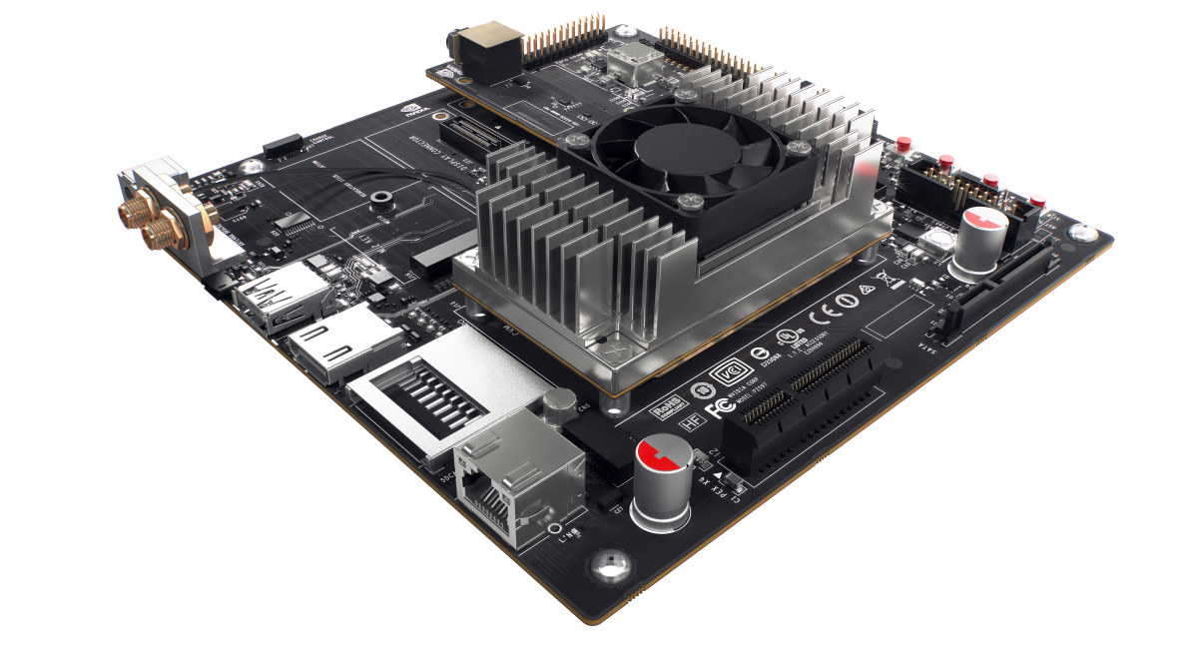
Processing Board
NVIDIA Jetson TX1
Hardware
  64 bit ARM A57
  256 CUDA core GPU
  4GB RAM
  15W power draw
Peripherals
  USB 3.0 Port
  Gigabit Ethernet
  GPIO header
    I2C
    UART
    SPI
  SATA port for HDD/SSD

Slide 23
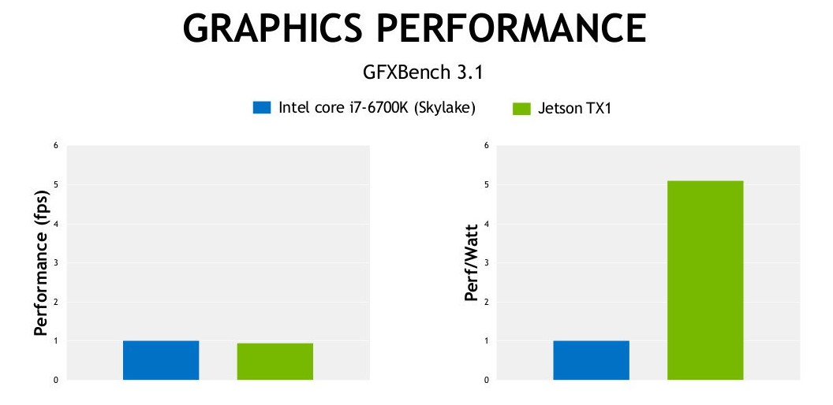
Jetson Power Efficiency
The graphics performance is even being reported by NVIDIA as being comparable to the i7-6700K's HD Graphics 530 in raw performance or 5x better with performance-per-Watt.

Slide 24
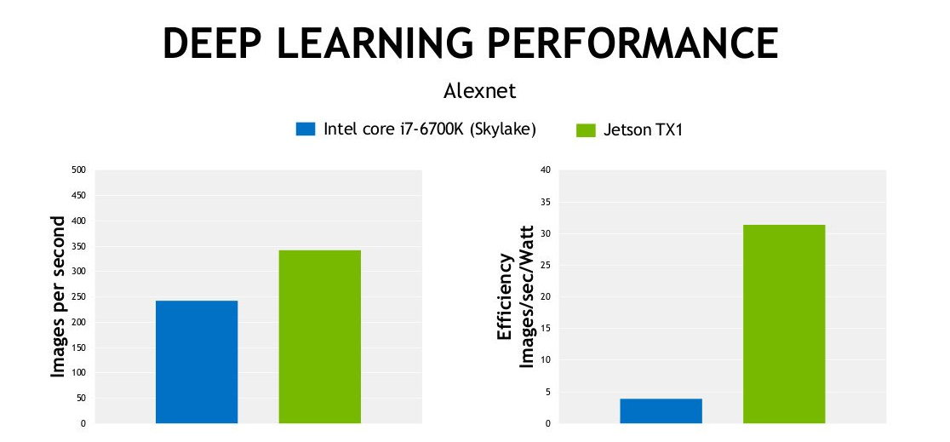
Jetson Computational Efficiency
The numbers supplied by NVIDIA report that the Jetson TX1 performance even beats out an Intel Core i7 6700K Skylake CPU when it comes to deep learning.

Slide 25
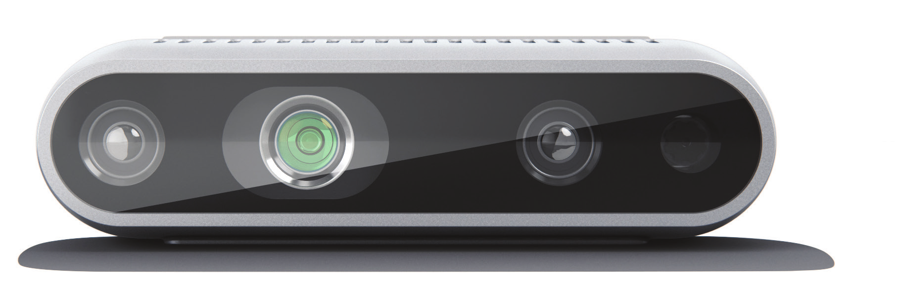
3D Camera
Intel Realsense D435
  Allows for image overlay, with point cloud for depth
  Structured-Light, Active IR stereo vision
  RGB Camera: 1920x1080
  Depth: 1280x720 @ 90 FPS
  Range: 0.1m to 10m
  RGB camera FOV: 69.4° x 42.5° x 77°
  IR FOV: 85.2° x 58°
  Indoor/Outdoor
  Global Shutter
Notes:
Power on page 48 datasheet, and specs pulled from overview

Slide 26

Realsense Software
Realsense SDK
  Open-source, cross platform
  Used for depth and image overlay
  OpenCV wrapper for image processing
  Creates Realsense point clouds easily
  Intended for robotics use
  Seamless integration with PCL

Slide 27

3D Rendering
PCL - Point Cloud Library
  Permissive open-source BSD license
  Depth capture tools and viewer
  Allows Point Cloud Registration*
  Intended for 3D mapping and localization
  Platform independent
*Alignment and stitching of similar clouds

Slide 28
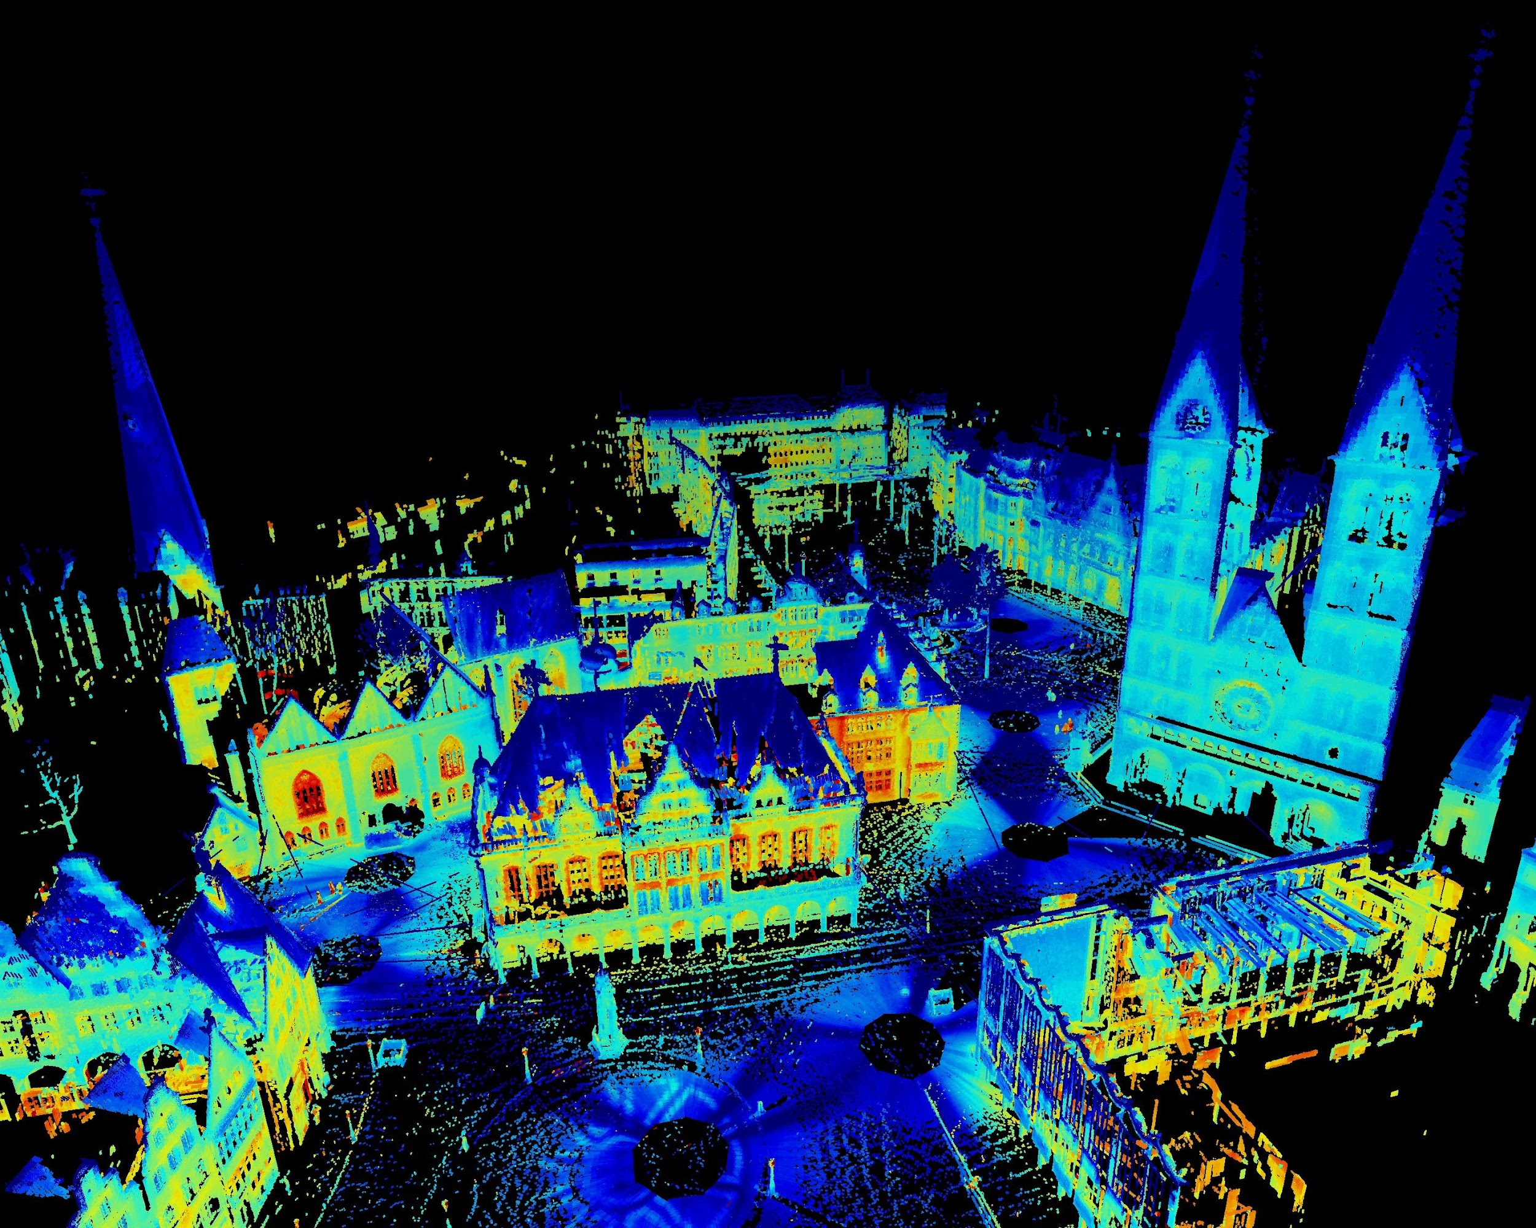
3D Capture - Point Cloud Data (PCD) Format
PROS
  PCL (Point Cloud Library) 3D capture file type
  Open-Sourced
  Designed for point clouds
  Self documenting
  Stores X,Y,Z and RGB data in ASCII matrix or binary
CONS
  Uncommon outside PCL

Slide 29
3D Capture - Polygon (PLY) Format
PROS
  Polygon 3D capture file
  Universally supported for 3D viewers
  Easily converted to PCD, or PCD to PLY
  Stores X,Y,Z and RGB data in ASCII matrix or binary
CONS
  Never intentionally designed for point clouds

Slide 30
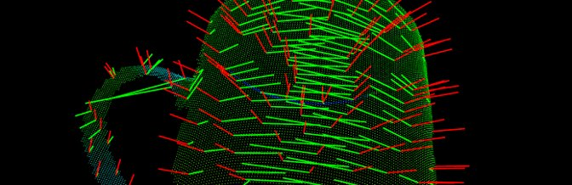
Other Notable 3D Capture Formats
Alternate 3D capture file types
STL
  Pros: Common 3D file type with small file size
  Cons: No RGB capture
OBJ
  Pros: Widely accepted file type easily portable to other applications
  Cons: No RGB capture
X3D
  Pros: “3D standard for web [HTML5]”
  Cons: Difficulty stitching multiple files

Slide 31
Robot Control / Viewing

Slide 32
Remote Access
Need to reliably control motor movement wirelessly and from a distance
Possibly operate device while it is not in direct line of sight of the user (e.g. in a different room)
Securely connect to device without possible interference from other signals

Slide 33
Remote Control
Bluetooth:
Bluetooth offers a low power, low cost, fairly secure solution to the motor control
Operating range varies from under 10m to 100m
Power consumption ranges from 1mW to 100mW
HC-05 Bluetooth Module
  Class 2: 10m operating range, 2.5mW
  easy to use
  compatible with many devices, including phones and other physical devices
Notes:
Daniel : In order to control our robot wirelessly, we’ll be utilizing bluetooth technology due to its low power and cost. Its operating range and power consumption will vary based on the bluetooth class. In our current implementation we will utilize the HC05 bluetooth module, which is class 2 and has an operating range of 10m and consumes about 2.5mW. We chose to use this due to our familiarity, ease of use, and its compatibility with many devices.

Slide 34
Remote Viewing
SHF Band WiFi - 5GHz
Avoid interference from 2.4GHz UHF Bluetooth band
Remotely view the 2D map and 3D
Accomplished with WiFi router for remote desktop
  VNC
  X2Go
  SSH application to host

Slide 35
Mechanical Assembly

Slide 36
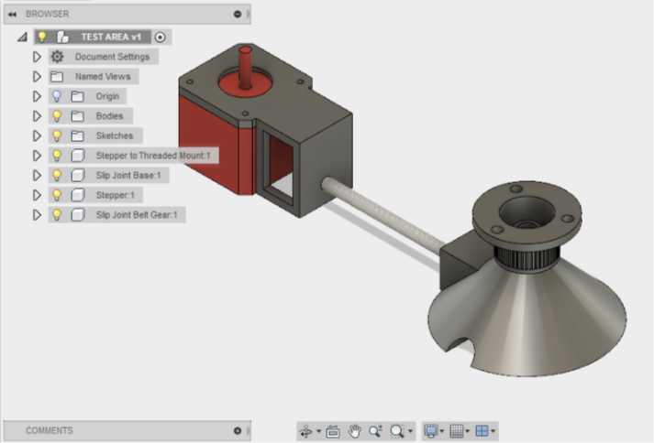
Top Level Motor Assembly
2D capture bay assembly, driven by stepper.

Slide 37
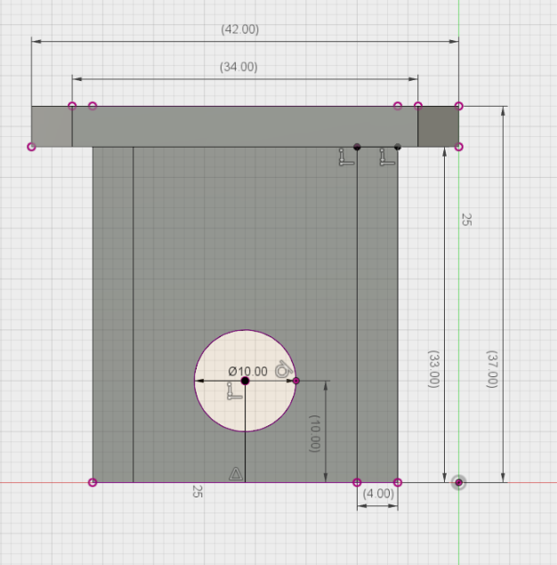
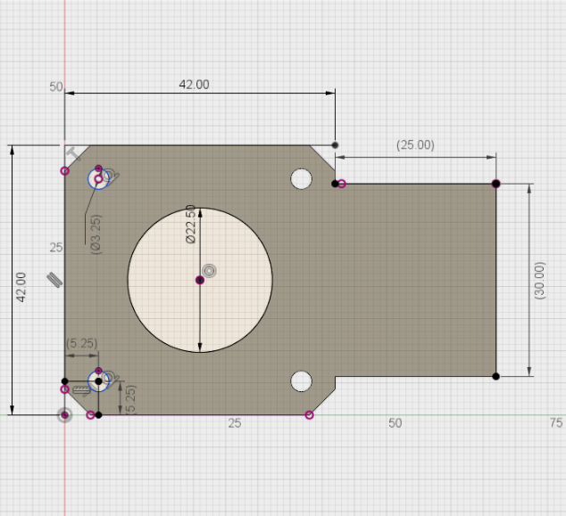
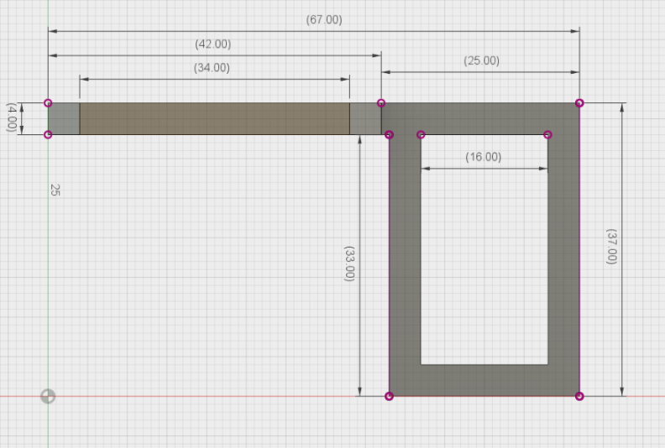
Motor Mount Assembly
Motor drive support assembly

Slide 38
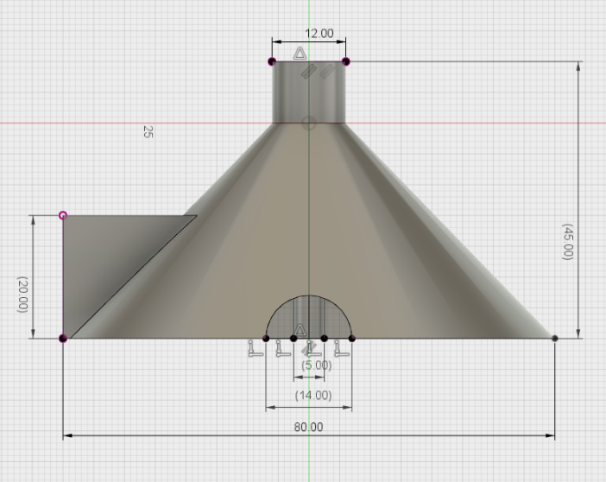
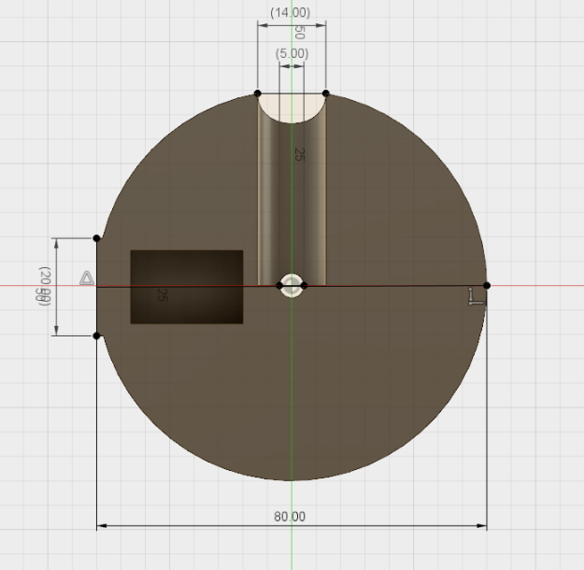
Motor Platter Assembly
Platter support assembly

Slide 39
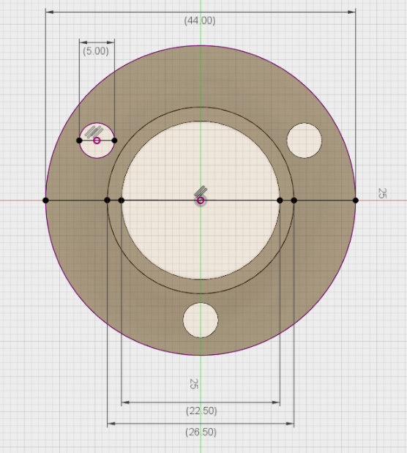
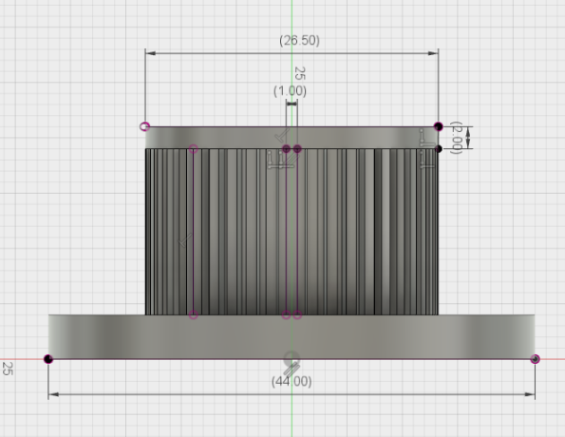
Platter Belt Ring Assembly
Gear Belt Platter Attachment

Slide 40
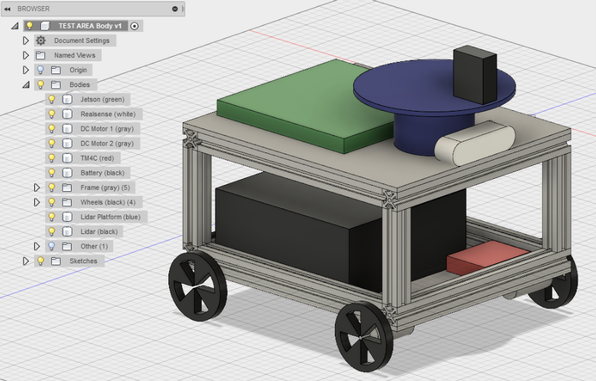
Final Complete Assembly Concept

